Slide 1

Fourth Sunday of Easter
St. Joseph Parish
May 8
-1

Slide 2
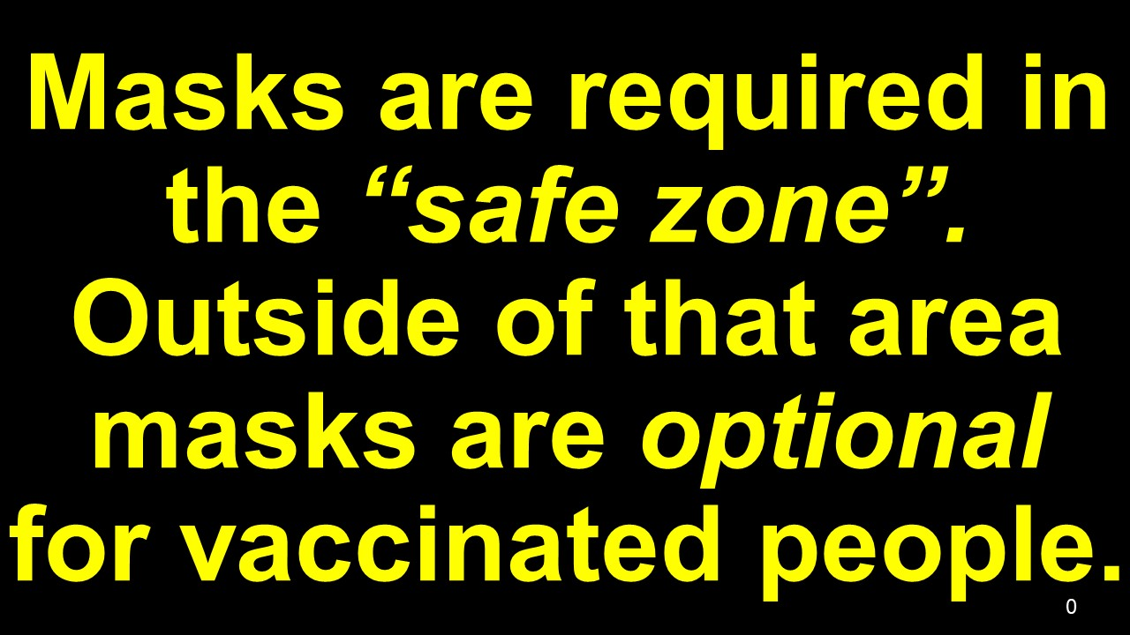
0

Slide 4
We are his people, the sheep
of his flock.

Slide 5
2

Slide 6
By our loving service and works of mercy
we invite every person to know
Jesus Christ,

Slide 7
present in the Word and the Breaking
of the Bread,
so that all may accept his gift of salvation.

Slide 8
66

Slide 9
We are his people, the sheep
of his flock.
B

Slide 10
4a

Slide 11
God of Mercy and Love, help us to
open our hearts to
the healing presence
of your Holy Spirit.

Slide 12
Guide us, your disciples, to fulfill your dreams for us and all of creation.

Slide 13
We ask this in the name our Risen Lord, Jesus, the Christ.
Amen.

Slide 14
5

