Slide 1
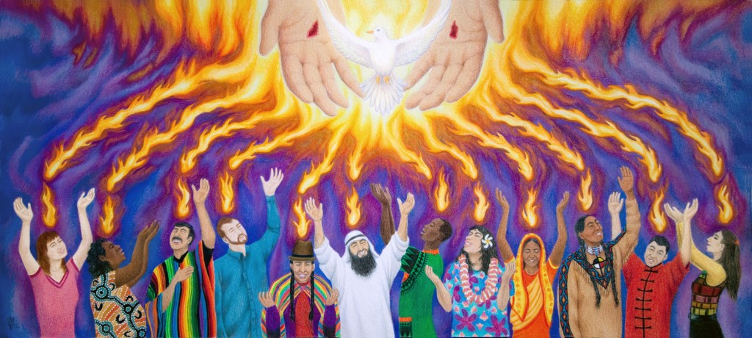
June 5
Pentecost Sunday - St. Joseph Parish
-1

Slide 2
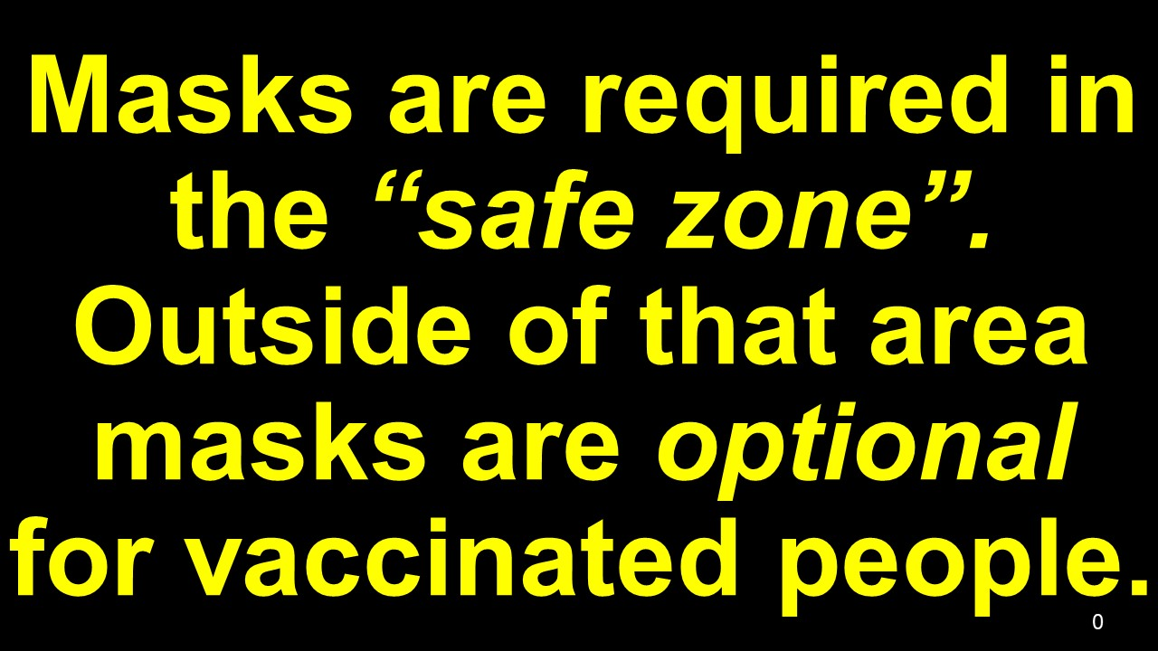
0

Slide 4
Lord send out
your Spirit,
and renew the
face of the earth.

Slide 5
2

Slide 6
By our loving service and works of mercy
we invite every person to know
Jesus Christ,

Slide 7
present in the Word and the Breaking
of the Bread,
so that all may accept his gift of salvation.

Slide 8
66

Slide 9
Lord send out
your Spirit,
and renew the
face of the earth.
B

Slide 10
4a

Slide 11
God of Mercy and Love, help us to
open our hearts to
the healing presence
of your Holy Spirit.

Slide 12
Guide us, your disciples, to fulfill your dreams for us and all of creation.

Slide 13
We ask this in the name our Risen Lord, Jesus, the Christ.
Amen.

Slide 14
5

